Slide 1


Keeping our community Covid safe

Slide 2
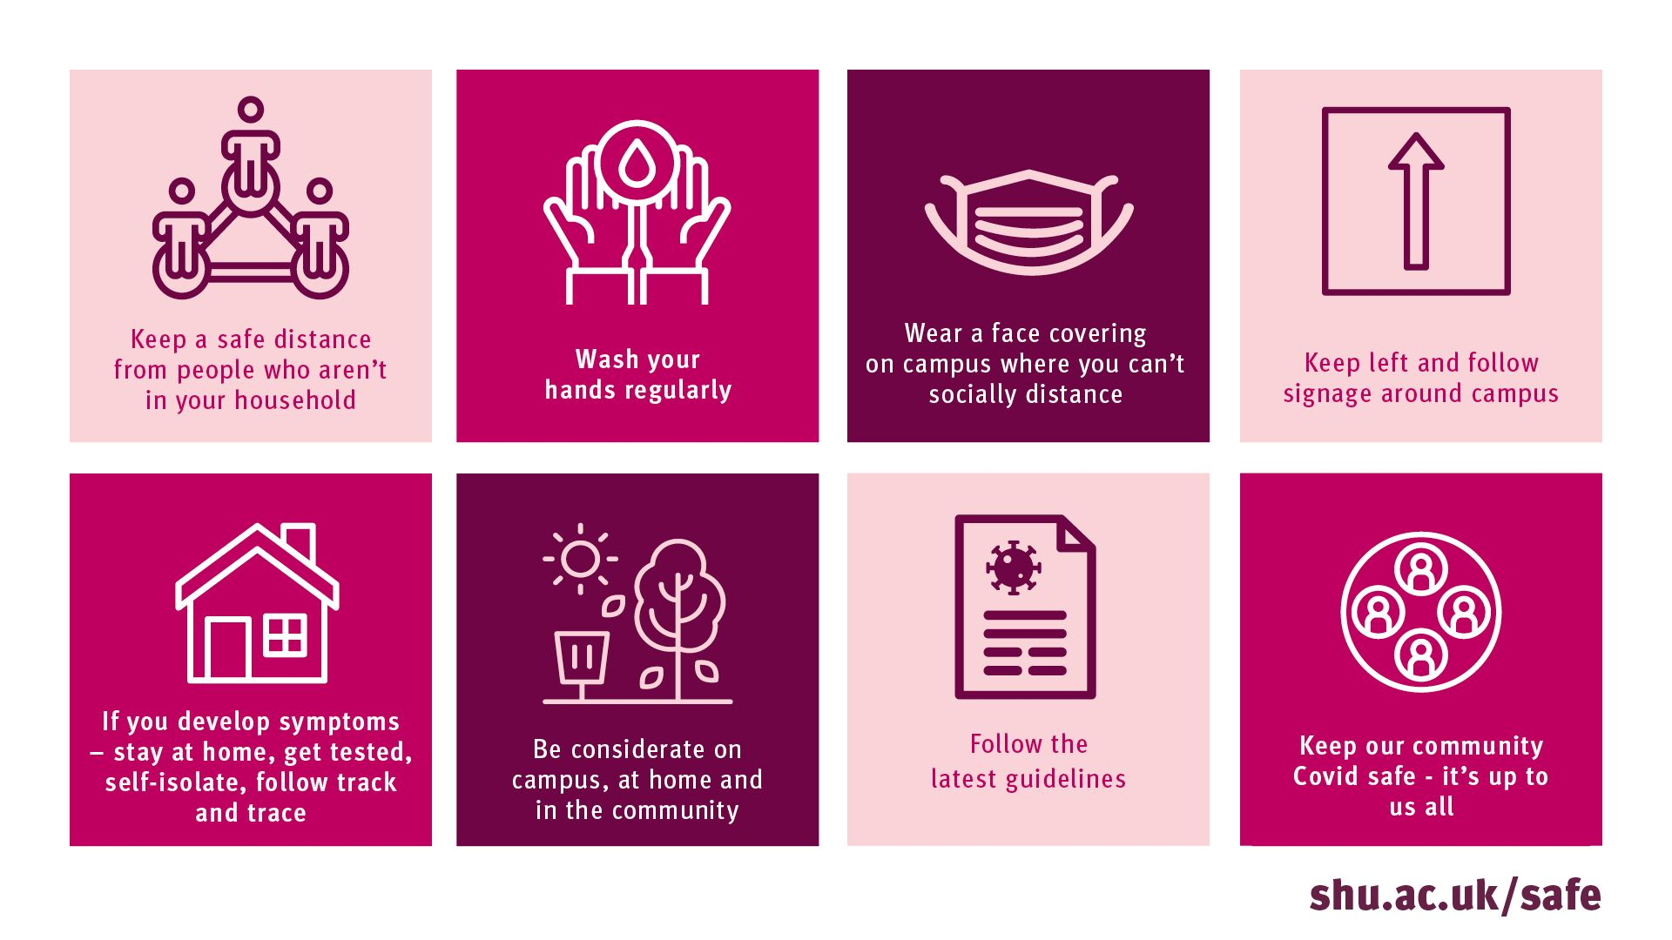
Key safety points

Slide 3

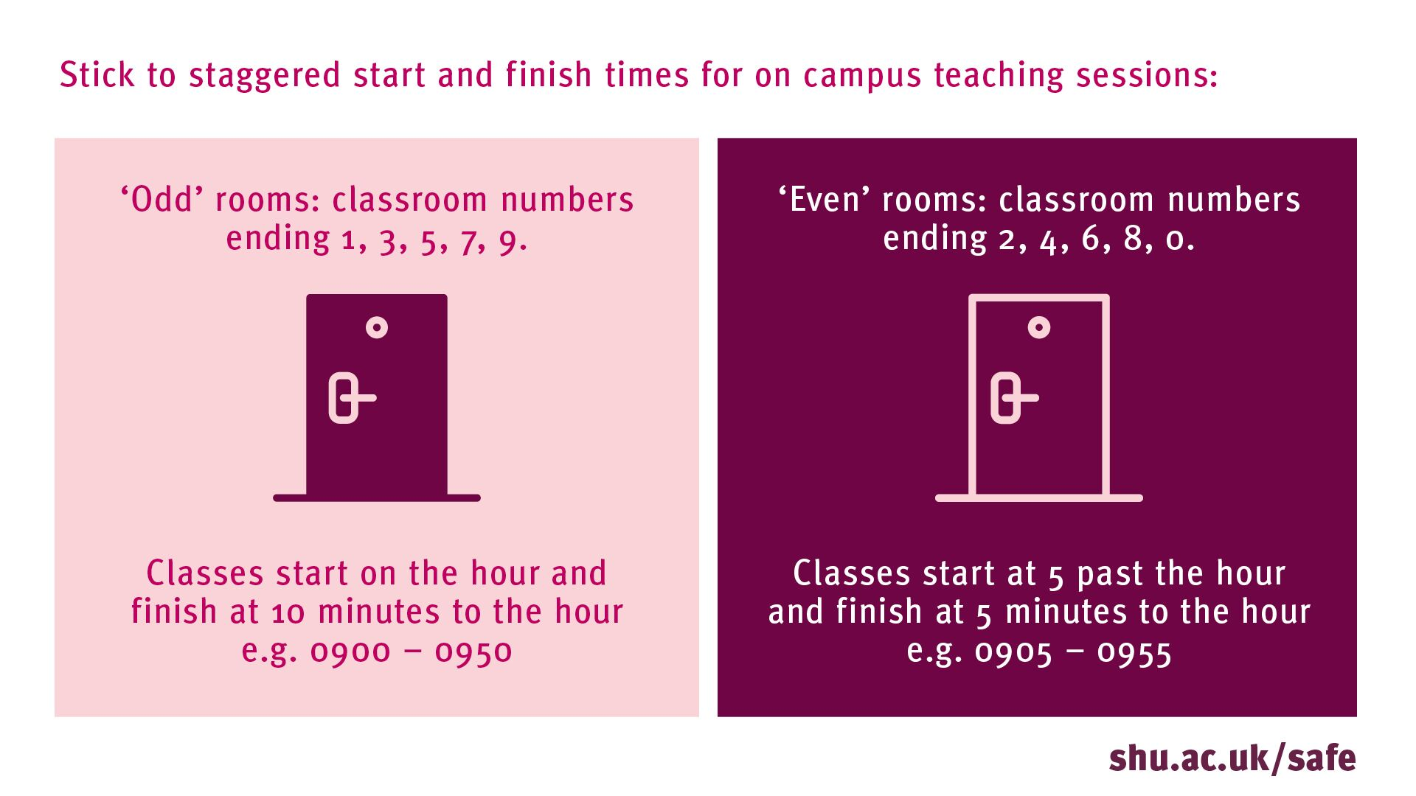
In teaching spaces
Fill classrooms from back to front,
and exit from front to back
In labs, studios, workshops etc
follow all guidance about where and how to work
Keep your face covering on,
unless you can spread out to more than 2 metres apart
If you’re exempt, you don’t need to wear a face covering - visors are available
Wipe down your desks /chairs / equipment before and after use

Slide 4
Staggered start and finish times

Slide 5
Potential changes to your timetable
A number of factors could result in your learning moving fully online, potentially at short notice, eg:
You or your lecturers having to self-isolate
Tighter restrictions being placed either on Sheffield or England as a whole
We will make sure you are informed and kept up to date – always check Blackboard/emails every day before coming to campus for updates on your timetabled face to face teaching sessions

Slide 6
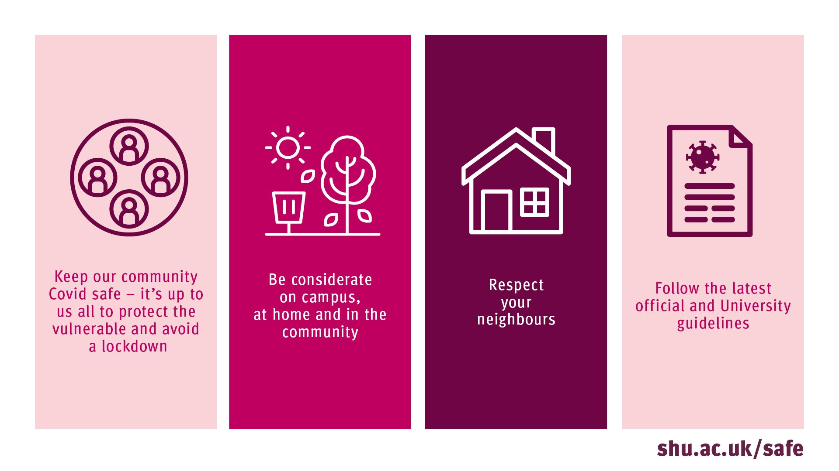
On campus and in the community
  Fire drills have been suspended - if you hear an alarm it’s real. Emergency evacuation takes precedence over Covid safety measures – exit the building in the most direct route. Check fire notices in all buildings you use.
  Stay safe in social spaces and cafes on campus - keep your distance from anyone not in your learning set/household group and wash your hands and wipe down surfaces.
  Be considerate on campus, at home and in the community – follow latest government guidance and don’t break the law when socialising.

Slide 7
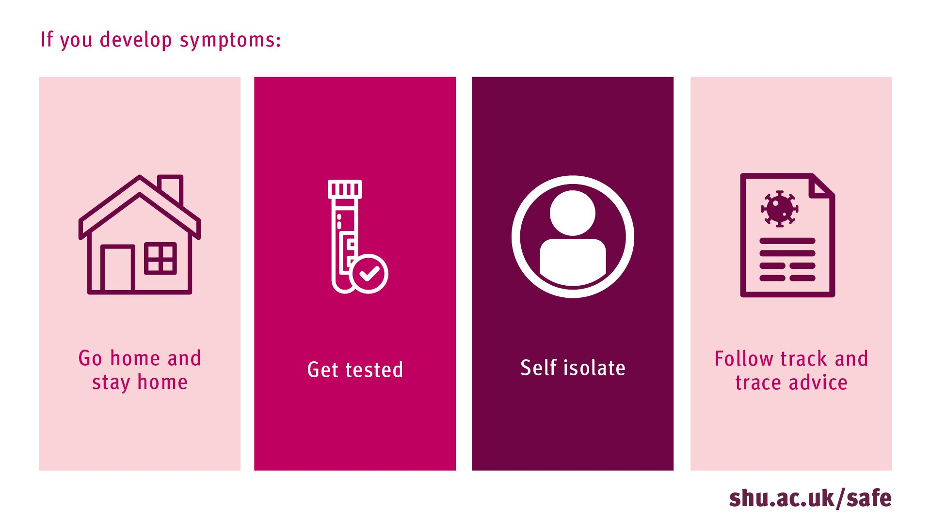
What to do if you’re unwell
You must go/stay at home and get a test
Tell the University – through the Covid-19 reporting form which is on the Keeping Safe on Campus site shu.ac.uk/safe
Self-isolate until you receive your results
If your test result is Covid positive:
Tell the University – through the same Covid-19 reporting form as above (even if you’ve already reported symptoms).
This is so that we can support you and carry out track + trace as required
Self-isolate.
Do not return to your family home (unless this is your term-time residence)
If your test result is Covid negative you can return to campus as soon as you’re well

Slide 8


Student Support Services
  All services are open operating on a ‘digital first’ basis, which provides the necessary resilience, reliability and accessibility for these uncertain times
  Hallam Help is the gateway to services:
    Self-help resources
    LiveChat
    Phone
    Email
    Book visits on campus including with your named Student Support Adviser
  Hallam Help points in Adsetts and Collegiate libraries
  Duty Student Support Advisers on campus daily

Slide 9

Visit https://shu.ac.uk/safe for more info

