Slide 1
Retention & Success: Constructing a Theory of Change
Hallam Symposium Series
Student Experience, Learning and Teaching
Student Engagement, Evaluation and Research
Nathaniel Pickering
Dr Liz Austen
April 2022

Slide 2
Aims of this session
Recap the ARAP evidence base and recommendations
Overview of the foundations evaluation, including Hallam Evaluation Strategy (APP)
Why a focus on change is important
The components of a Theory of Change
Activity: discussing how a Theory of Change helps activity/intervention design
Theory of Change progress at Hallam and how STEER can help

Slide 3
Recap of the last session: evidence
Unpicked factors impacting on student retention and success (Austen et al 2021), relating these to the concept of ‘mattering’
Reflect on lessons learned from recent practices and what this means for the future within the Hallam context
Recording: https://www.youtube.com/watch?v=4fzfk_LnFCE

Slide 4
Access, retention, attainment and progression: an integrative review of demonstrable impact on student outcomes
Findings
Limitations of the review included: a lack of evidence on long-term student outcomes; outcome definitions which risked overlooking intermediary/mediating factors; a dominance of quantitative studies aligned with metric-driven student outcome definitions.
Recommendations
Evaluation strategies, including resourcing and a commitment to long-term evidence generation, should be built into project plans and business cases.
Ensure that projects are accountable for the measurement of long-term impact beyond ‘alignment’ to strategy at the point of funding

Slide 5
Hallam’s Evaluation Strategy
Sheffield Hallam Access & Participation Plan
“We will embed an evaluation mindset in our approach; it will be a core competency of staff and will drive objective setting, activity/intervention design and our teaching and learning. We will be joined-up, aligning evaluation with our work on TEF, equality objectives and privacy impact assessments, and avoiding duplication and repetition.”
Access
Retention
Attainment
Progression
Notes:
Aspiration of APP refresh: all examples of activities cited in the APP have an accompanying Evaluation Plan (Theory of Change and evidenced claims against short, medium, long term outcomes).

Slide 6
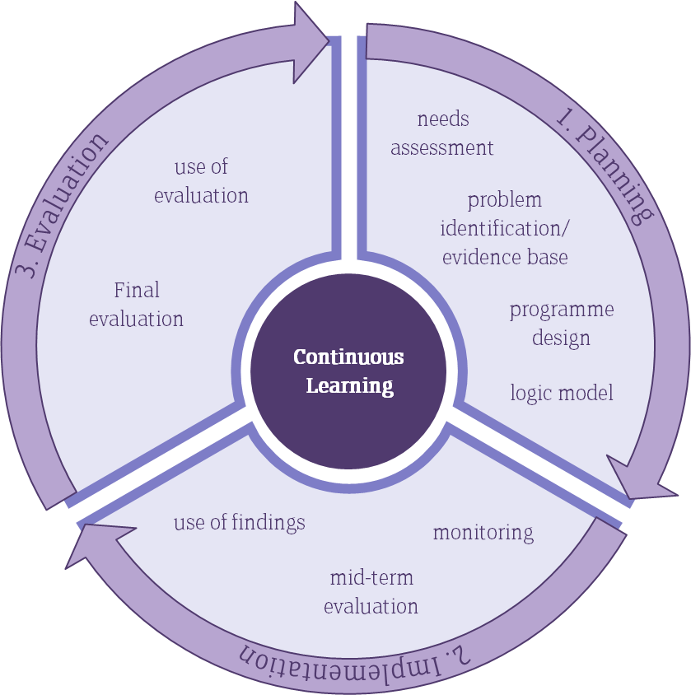
Evaluation is...
In the chat, how would you define evaluation?
Worth and Value
Evaluation is defined as a periodic assessment of the relevance, performance, efficiency and impact (both expect and unexpected) of the project in relation to stated objectives.
(Fort, Martinez, & Mukhopadhyay, 2001)
Social Justice
Inclusive evaluation involves a systematic investigation of the merit or worth of a programme... for the purpose of reducing uncertainty in decision making and to facilitate positive social change for the least advantaged.
(Mertens, 1999, p.5)

Slide 7
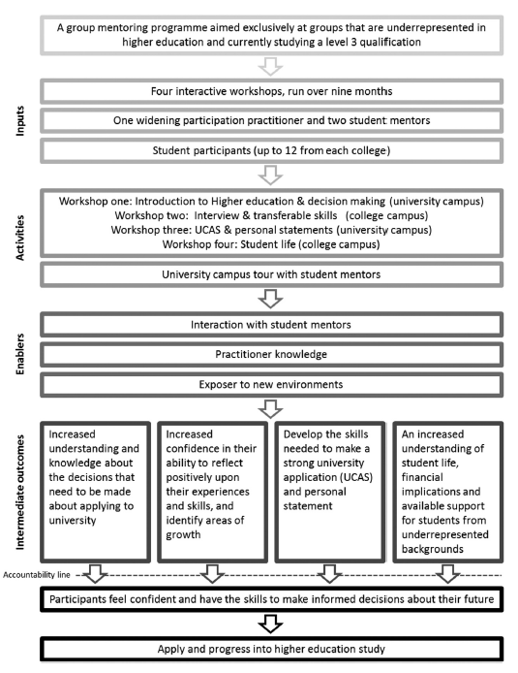
A Theory of Change is...
A theory of change is a tool to help you describe the need you are trying to address, the changes you want to make (your outcomes), and what you plan to do (your activities). The approach can be used for organisations of all shapes and sizes—from service-delivery charities, to campaigning organisations, to funders. A theory of change is often represented in a diagram or chart, but a full theory of change process involves more than this.
(Harries, Hodgson & Noble, 2014)
Pickering (2021)​

Slide 8
Key Elements of a Theory of Change
Situation
Aims/Goals
Rationale
Inputs
Activities
Outputs
Outcomes
Evidence: Barriers
Evidence: What Works
Assumptions

Slide 9
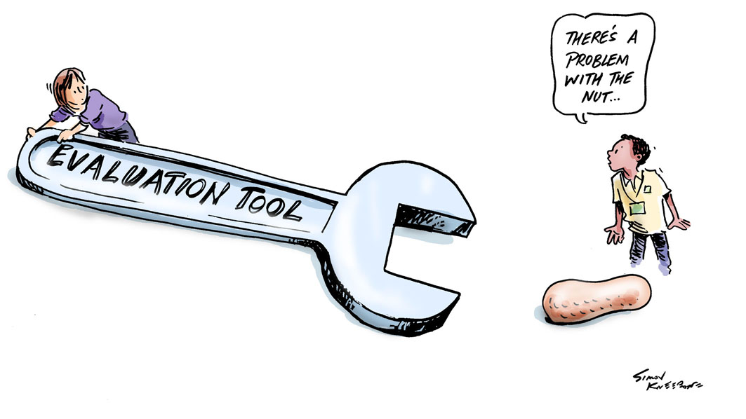
The Demise of Aimhigher
[Aimhigher's] ‘lack of progress’ was at least partly due to a confusion in the implementation of the policy aim, leading... [among other things], to the late adoption of a poor outcome measure that underestimated improvements in participation from the target groups and focused on the wrong stage of entry to higher education (Harrison, 2012)

Slide 10
Identifying and Measuring Change
Who
Where
How
When

Slide 11
Access and Participation Plan Targets
Access
To increase the proportion of new entrants who are Black by 40%, so that Black entrants represent 6% of all by 2024/25.
Continuation
To improve the continuation rates of most disadvantaged male students eradicating all gaps by 2024-25.
Attainment
To improve the degree attainment of black students; disabled students; most disadvantaged males and most disadvantaged BAME students, eradicating all gaps by 2024- 25.
Progression
To improve graduate outcomes for students who are: from an Asian background, disabled, most disadvantaged males and most disadvantaged BAME students, eradicating all gaps by 2029-30.

Slide 12
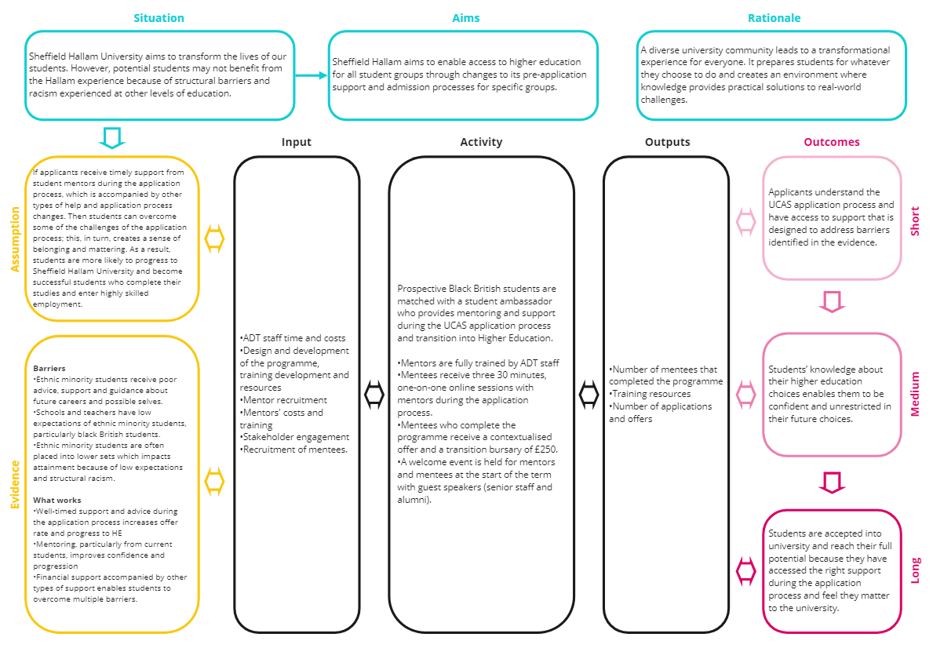
Theory of Change Construction
Has the target been met?
Do we know why it has been met or not?

Slide 13
Context (Pre-Theory of Change)
Situation
Aim
Rationale
Sheffield Hallam University aims to transform the lives of our students. However, potentially Black British students may not benefit from this transformational experience because of structural barriers and racism experienced at other levels of education.
Sheffield Hallam aims to enable access to higher education through changes to its pre-application support and admission processes for specific groups.
A diverse university community leads to a transformational experience for everyone. It prepares students for whatever they choose to do and creates an environment where knowledge provides practical solutions to real-world challenges.

Slide 14
Context (Continually Evolving)
Evidence
Assumption
Barriers
Ethnic minority students receive poor advice, support and guidance about future careers and possible selves.
Schools and teachers have low expectations of ethnic minority students, particularly black British students.
Ethnic minority students are often placed into lower sets which impacts attainment because of low expectations and structural racism.
What works
Well-timed support and advice during the application process increases offer rate and progress to HE
Mentoring, particularly from current students, improves confidence and progression
Financial support accompanied by other types of support enables students to overcome multiple barriers.
If applicants receive timely support from student mentors during the application process, which is accompanied by other types of help and application process changes. Then students can overcome some of the challenges of the application process; this, in turn, creates a sense of belonging and mattering. As a result, students are more likely to progress to Sheffield Hallam University and become successful students who complete their studies and enter highly skilled employment.

Slide 15
Outcomes
Short
Medium
Long
Applicants understand the UCAS application process and have access to support that is designed to address barriers identified in the evidence.
Applicants’ knowledge about the higher education application process enables them to be confident and unrestricted in their future choices.
Applicants are offered/accepted into university and reach their full potential (transformed) and feel they matter to the university.

Slide 16
Activity Development – Peer Mentoring
Inputs
Activities
Outputs
ADT staff time and costs
Design and development of the programme, training development and resources
Mentor recruitment
Mentors' costs and training
Stakeholder engagement
Recruitment of mentees.
Prospective Black British students are matched with a student ambassador who provides mentoring and support during the UCAS application process and transition into Higher Education.
Mentors are fully trained by ADT staff
Mentees receive three 30 minutes, one-on-one online sessions with mentors during the application process.
Mentees who complete the programme receive a contextualised offer and a transition bursary of £250.
A welcome event is held for mentors and mentees at the start of the term with guest speakers (senior staff and alumni).
Number of mentees that completed the programme
Training resources
Number of applications and offers

Slide 17
Theory of Change and Evaluation
Identification of monitoring data
Impact on participants/organisation
Measure change
Test assumption(s)
Timing (avoiding quick wins and leaky pipes)
Refine evidence
The counterfactual (unintended/negative consequences)
Has the target been met?
Do we know why it has been met or not?
Processes
Experience of intervention
Test relationships

Slide 18
Theory of Change and Evaluation
Refine evidence
Test assumption(s)
Measure if outcomes have been met
Test the relationship between outcomes and activities
Identification of monitoring data
Experience of the activities/training
The counterfactual (unintended/negative consequences)
Impact on participants
Timing (avoiding quick wins and leaky pipes)
Has the aim been met, and do we understand why it has been met or not?

Slide 19
Activity: How would a Theory of Change help in this scenario?
Context: 60% of students at the University of Magic Enterprise are from under represented groups. The institution has seen an increase in student withdrawals over the last 12 months and is looking for an intervention which will address this. The current financial climate of increased hardship is assumed to be a key factor.
Action: Acknowledging student need, the Financial Services Team at the University of Magic Enterprise decide to offer large sums of money (£1,000) to students on a first come first served basis until the limited budget they have (£100,000) is spent. Students can attend an in person Helpdesk during the Easter vacation with a copy of a their bank statement and ID. Student numbers are retained.
Evaluation: The Financial Services Team construct a new business case for funding as they believe they are in need of more money to support more students . ULT, as funders, want to know what impact the Financial Support Bursary has had, particularly for students who experience barriers to their learning, and how much additional funding would be most effective.
Notes:
Activity:
what is the evidence base on which this intervention is based?
what assumptions are being made about student needs, university resourcing and why a bursary scheme might work?
what are the short, medium and long terms outcomes of such an intervention?
What are the risks/enablers/barriers?

Slide 20
Financial Support Logic Model + Context & Assumptions
Context: 60% of students at the University of Magic Enterprise are from under represented groups. The institution has seen an increase in student withdrawals over the last 12 months and is looking for an intervention which will address this. They consult the evidence and conclude that a financial support bursary for students in financial disadvantage would work.
Assumptions: Financial hardship exists for some students and not others; financial support reduces the need to work excessive hours and study; financial support has a psychological effect on motivation and belonging.
Inputs to address the challenge, including funds and resources
Activities to bring about change
Outputs, which are the deliverables and milestones
Outcomes, the short & medium term results/change
Impact, the long term results/change
Income (fees, donations, funding allowances)
Total budget for bursary (£)
Staff times (bursary design, promotion, applications, evidence gathering, payments)
Design and Implement a Financial support Bursary Scheme for students who can evidence financial hardship
X students apply for financial support
X students receive financial support
X amount of money is distributed to students
Short:
All students are aware of and understand the financial support offer
Financial support is used by students to pay for living costs and/or university costs and/or leisure activities
Long term impact: Students who have received financial support complete their year of study.
Students who have received financial support obtain comparable attainment to those who did not received financial support.
Positive OFS feedback on APP leads to stable student fees
Medium:
Students in hardship feel that they matter and the University values them
Students in hardship are able and motivated to attend and engage in their teaching and learning.
Notes:
This is the correct version – this is what the user is aiming to complete.
NB / need to check the content beyond this rough draft.

Slide 21
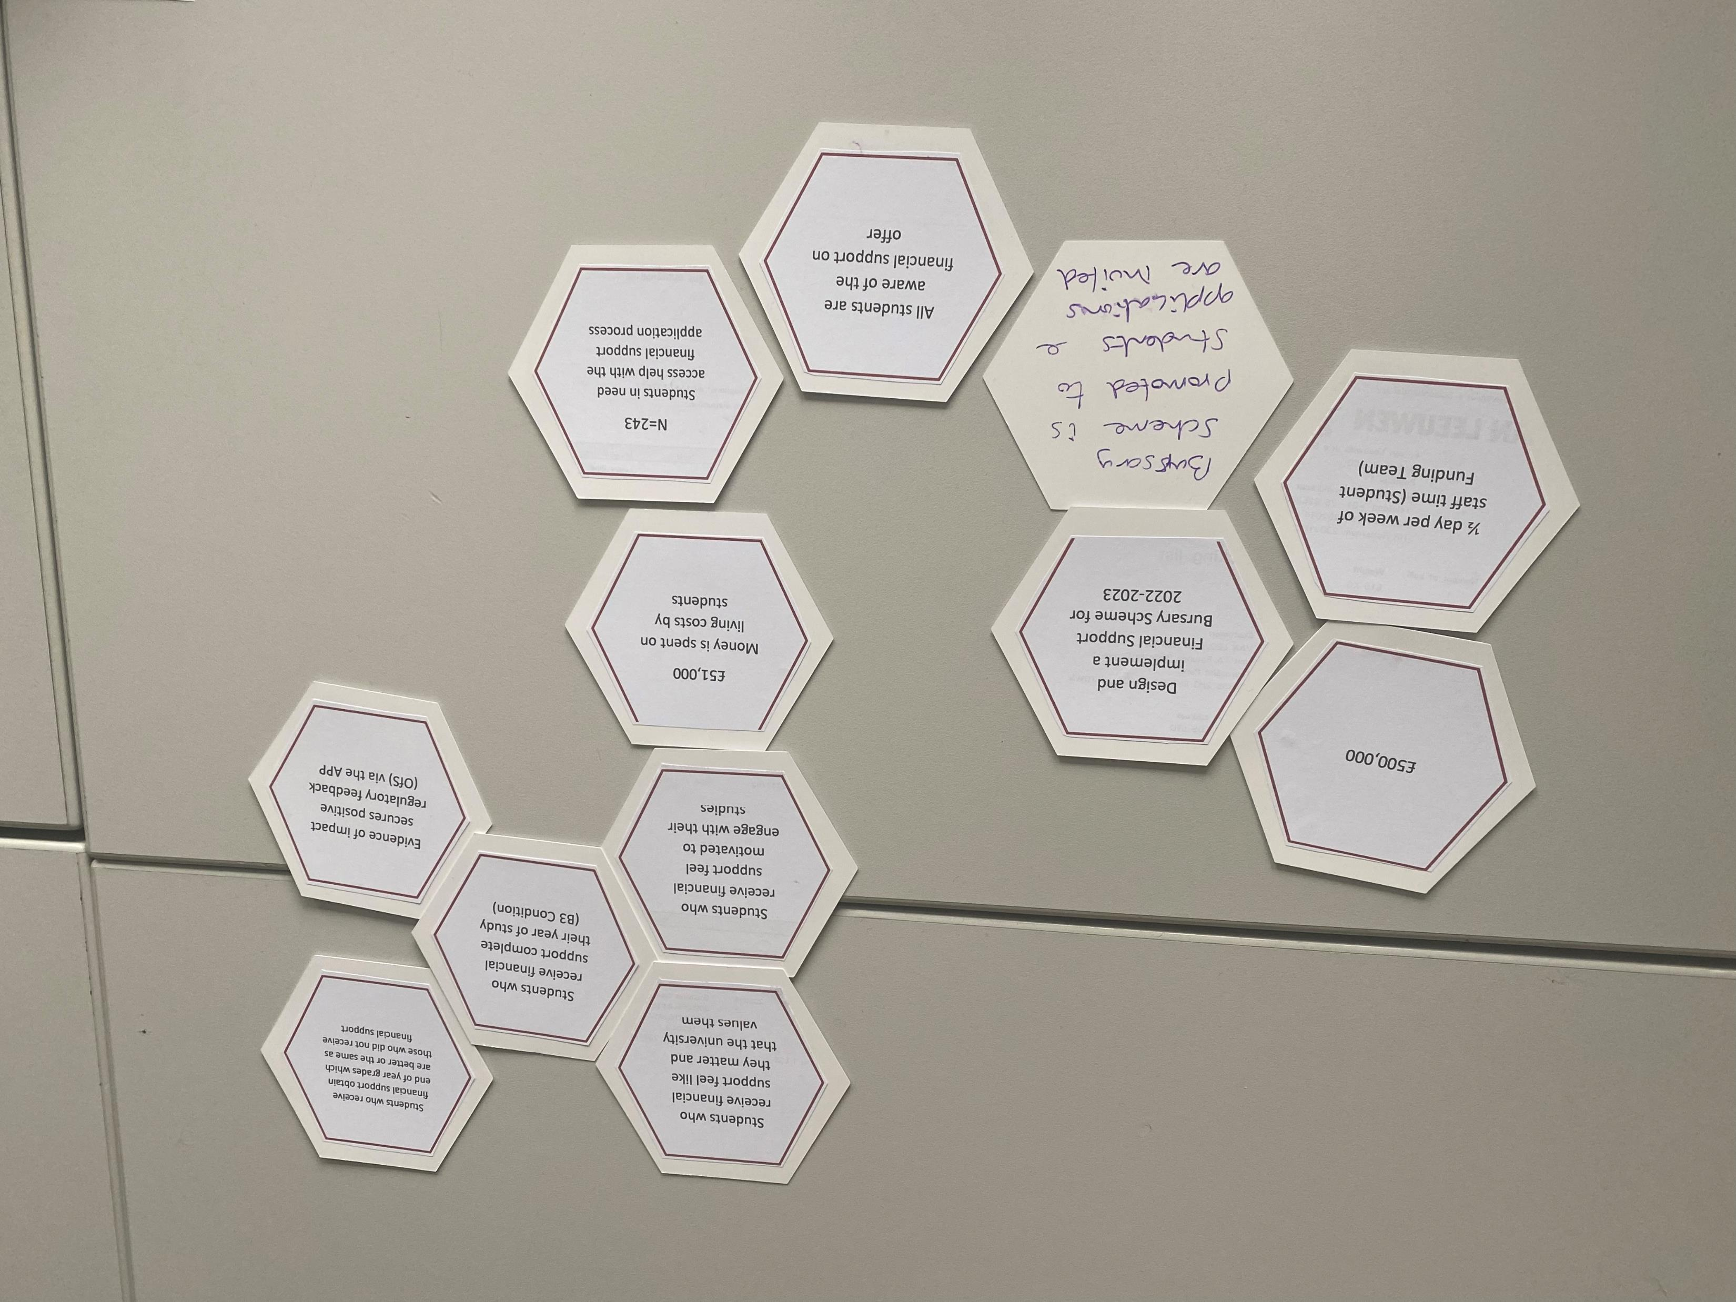
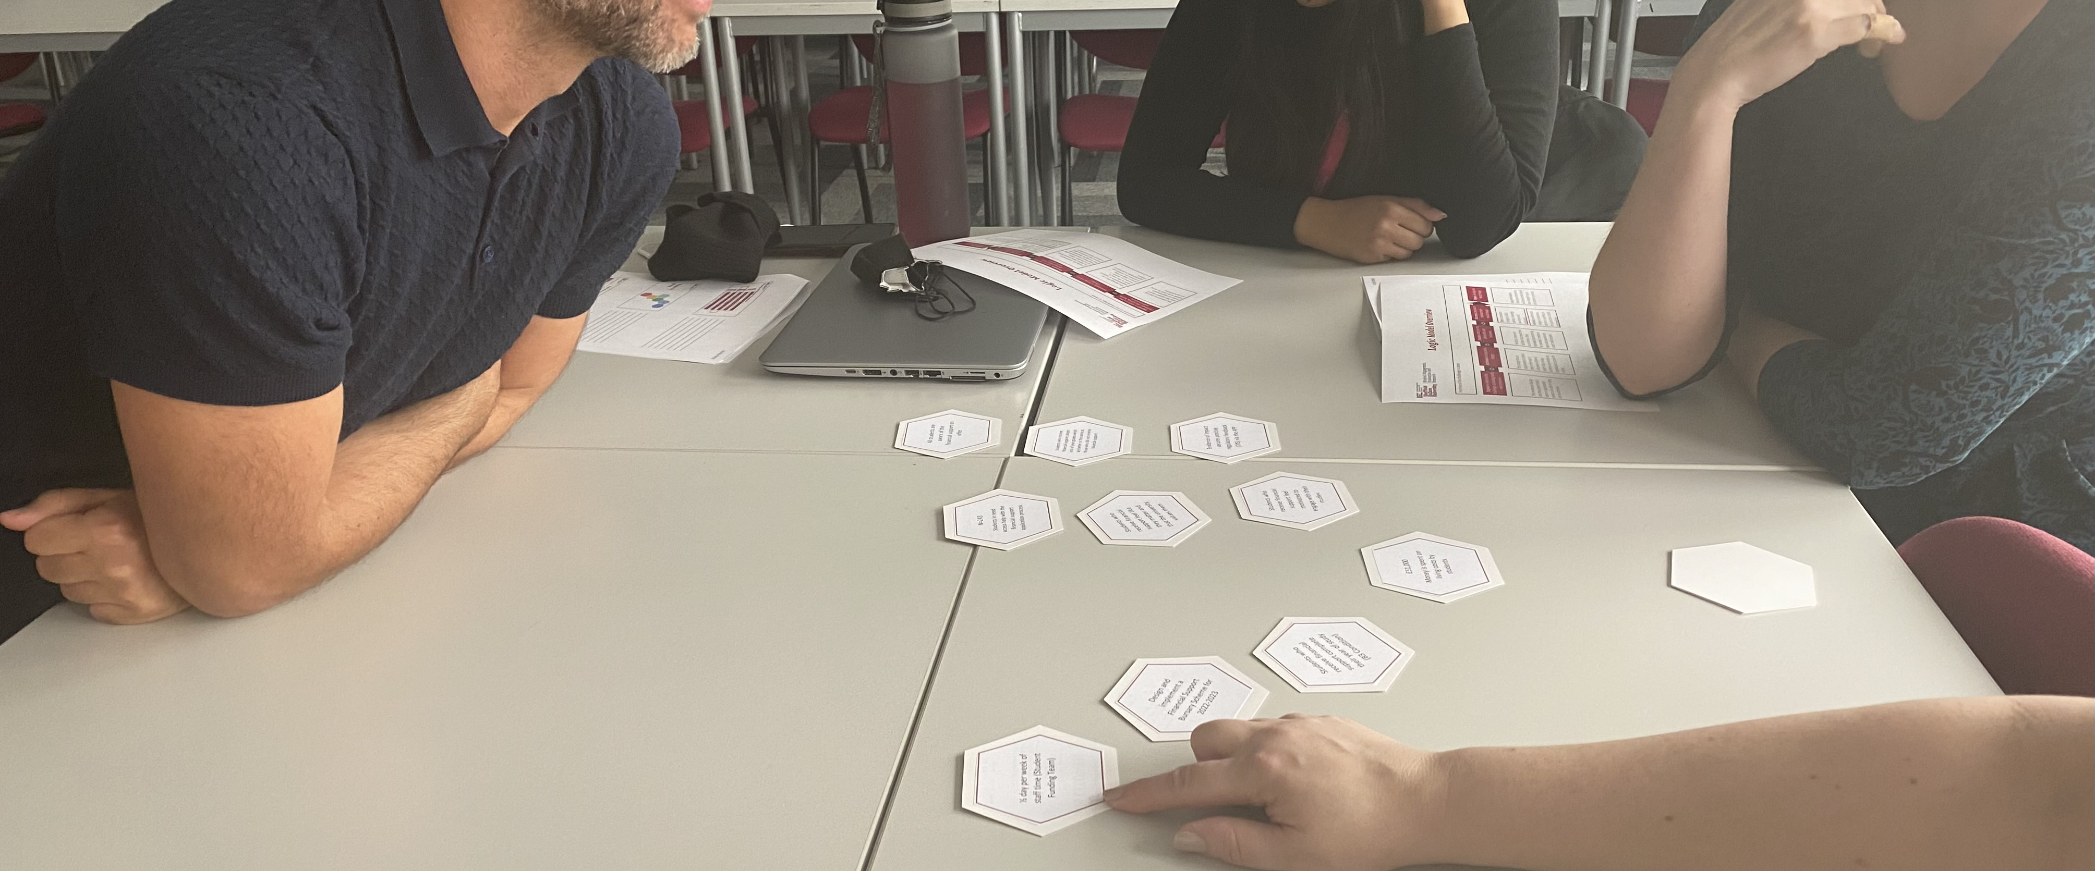
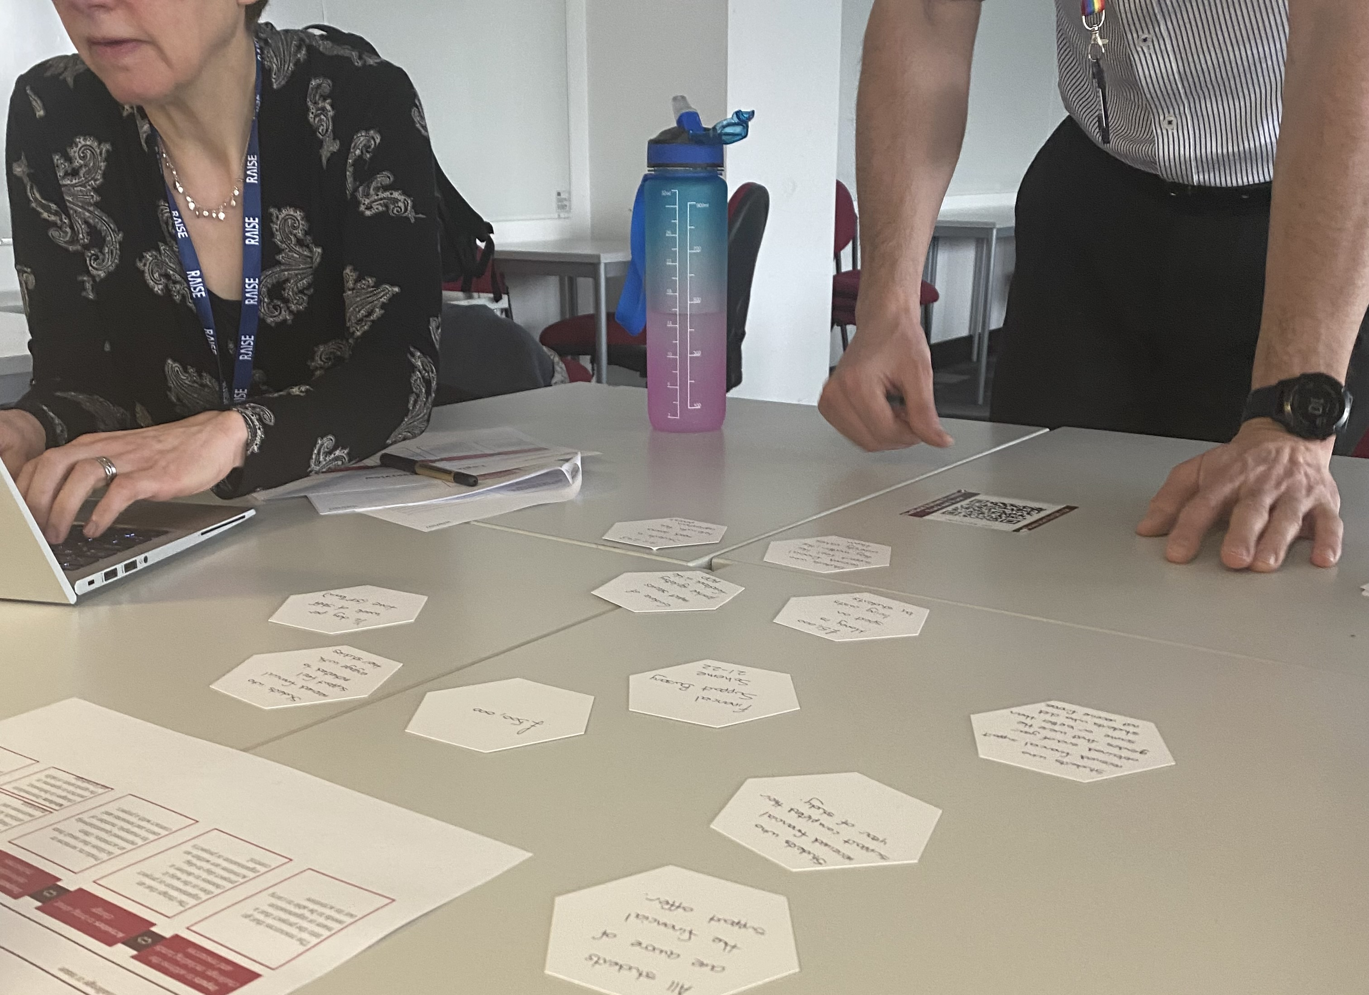
TOC principles: - collaborative - not always linear - iterative - a minimum expectation - best conducted at the point of intervention design - must be followed by an evaluation plan

Slide 22
How is Hallam using a ToC? https://blog.shu.ac.uk/steer/2022/02/18/everybodys-talking-abouttheory-of-change/
ACCESS | SUCCESS (ATTAINMENT/RETENTION) | PROGRESSION
The Hallam Skills Series Outreach initiative created to support the development of essential life skills, starting in Y9 all the way though to Y11. Definition of outcomes – short term (throughout HSS), medium term (from year one of HSS) and longer term (post HSS) – and guiding measurement and evidence and evaluation planning. | PG Academic Advising Models Developing evidence-informed models of PGT academic advising ToC at the outset of design, implementation, and ongoing evaluation of the impact of these approaches. This ToC was co-constructed by a PG AA Evaluation Working Group. | Class 2021+ 8 component interventions to support all students as they transitioned to graduate employment or further study. ToC that identified clear and measurable outcomes focused on changes in awareness, knowledge, skills or behaviours of participants and stakeholders. Evidence of developing an evaluative mindset, expressed as a cultural shift for those involved.
Notes:
The Hallam Skills Series
Outreach initiative created to support the development of essential life skills, starting in Y9 all the way though to Y11..
STEER supported the definition of outcomes – short term (throughout HSS), medium term (from year one of HSS) and longer term (post HSS) – and guiding measurement and evidence and evaluation planning.
PG Academic Advising Models
Developing evidence-informed models of PGT academic advising was initiated.
STEER supported the design, implementation, and ongoing evaluation of the impact of these approaches.
Is using a Theory of Change to link a rationale for change to intended impact and crucially, help to develop the PGT AA models themselves. This ToC was co-constructed by a PG AA Evaluation Working Group.
Class 2021+
8 component parts which complemented each other to best meet the needs of all students as they transitioned to graduate employment or further study.
Used a Theory of Change or logic model that identified clear and measurable outcomes focused on changes in awareness, knowledge, skills or behaviours of participants and stakeholders.
In addition to exploring impact and process within the Class 2021 programme, support from STEER further developed an evaluative mindset, expressed as a cultural shift for those involved.
In the last month, STEER have supported evaluation work with colleagues working in Place and Civic Engagement Team (inc Children’s University), Access & Development Team, HEPP, Equality Objectives and Hallam Values in HROD, and the Harassment, Sexual Misconduct & Hate Crime Programme.

Slide 23
STEER’s role in “building an evaluative mindset”

Slide 24
Questions...
Monday 6 June 9:30-11am: Retention & Success: Evaluation Planning and Implementation
This final session in the series outlines approaches to evaluating the impact of change by discussing methods of data gathering and types/standards of evidence. Closing the symposium will be Professor David Shephard, Deputy Vice-Chancellor (Academic).

Slide 25
References
Austen, L., Hodgson, R., Heaton, C., Pickering, N., & Dickinson, J. (2021). Access, retention, attainment, progression – an integrative literature review. AdvanceHE. https://www.advance-he.ac.uk/news-and-views/access-retention-attainment-progression-integrative-literature-review
Harries, E., Hodgson, L., & Noble, J. (2014). Creating your Theory of Change: NPC’s Practical Guide. London: New Philanthropy Capital.
Fort, L., Martinez, B L., Mukhopadhyay, M. (2001). Integrating a gender dimension into monitoring and evaluation of rural development projects. Washington DC: World Bank.
Mertens, D. M. (1999). Inclusive Evaluation: Implications of Transformative Theory for Evaluation. American Journal of Evaluation, 20(1), 1–14
Pickering, N. (2021). Enabling equality of access in higher education for underrepresented groups: a realist ‘small step’ approach to evaluating widening participation. Research in Post-Compulsory Education, 26 (1), 112-130. http://doi.org/10.1080/13596748.2021.1873410
Resources
STEER Blog
Building an Evaluative Mindset at Hallam: Our Approach - https://blogs.shu.ac.uk/steer/2019/10/14/building-an-evaluative-mindset-at-hallam-our-approach/?doing_wp_cron=1585644842.5892319679260253906250
Building an Evaluative Mindset at Hallam: Our Strategic Context - https://blogs.shu.ac.uk/steer/2019/11/22/building-an-evaluative-mindset-at-hallam-our-strategic-context/?doing_wp_cron=1585644875.0418930053710937500000
Building an Evaluative Mindset at Hallam: Programme (Activity/Intervention) Design - https://blogs.shu.ac.uk/steer/2020/01/20/building-an-evaluative-mindset-at-hallam-programme-activity-intervention-design/
Contact details
Twitter: StEER_SHU
Email: steer@shu.ac.uk

