Slide 1
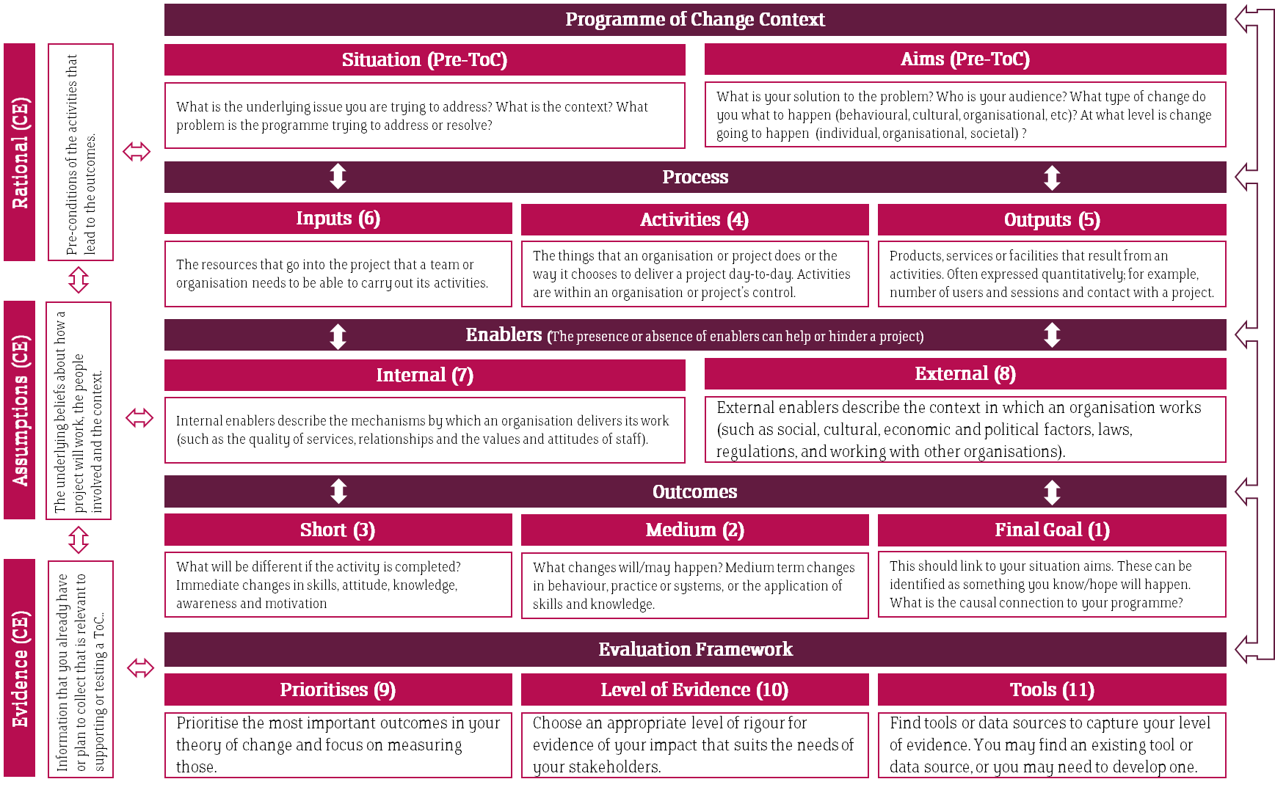
Theory of Change Template
Instructions on Completion
Complete the boxes in the numerically order indicated. The Situation and Aims should be established prior to creating your theory of change diagram.
The Evidence, Assumptions and Rational should underpin the theory of change and should “continuously evolve” (CE) overtime as you design and implement your programme.
The arrows illustrate the relationship between different elements in the theory of change. Essentially each element flows into and from one another and are all interconnected. When considering your evaluation framework you need to consider each of the elements of the theory of change and if necessary how it will be evaluated.

Slide 2
Hallam Skills Series: Outcomes
Short term Outcomes (Throughout HSS)
Intermediate Outcomes (From Year One of HSS)
Long term Outcomes (Post HSS)
Design and run activities that help develop the five core skills in...
Raise, improve and support students to...
Successful design and run a long term programme for pre-16 that...
SHU
Core Skills
Citizenship
be confident in their abilities and individuality
Improved Behaviour and Engagement in Education
Confidence
reflect on their strengths and development
Raised School Attainment
Participants
Critical thinking
Resilience
succeed in learning, life and work
Apply and Progress to Higher Education
Self-management
Evidence: Pre-intervention survey: Behaviour towards HE; School Liaison interviews; Caricature activity
Assumptions: The current school curriculum does not provide student with the opportunity to develop essential skills that will help them succeed in learning, life and work. Student from disadvantaged backgrounds also have less opportunity to participate in extra-curricula activities that would help then identify and strengthen certain skills, which would then impact them for the rest of their lives.
Notes:
Need to put a year by year plan

Slide 3
Outcomes
PG Academic Advising: Outcomes
While the AA framework is generally well embedded in UG delivery practice for PG taught courses, it is less well established and the landscape of delivery of AAing to PG courses across the University is not fully known. Furthermore, there are many different types of PG course and it is likely that the student demographic varies incredibly. Therefore, it is likely that PG students have a wide variety of wants and needs from the AA offer. There is a need to identify the different types of course and provide model(s) of AAing that align with the AA Framework and individual needs of courses, then evaluate the impact of those models of delivery.
Short
Medium
Final Goal
Awareness of the specific issues related to PGT academic advice is increased
Students report feeling supported in their academic progression, personal and professional development
PGT students are more confident in their future career choices
All students are aware of the AA role
Staff report feeling able to support PG students appropriately
The retention of PGT students is improved
All Students know who their Academic adviser is (measured Jan 2023?)
The use of AAing tools (such as the Grow+/PebblePad online)are effective in enabling staff and students to feel supported in their respective roles (process outcome)
Hallam has a reputation for providing a supportive environment for PGT students.

Slide 4
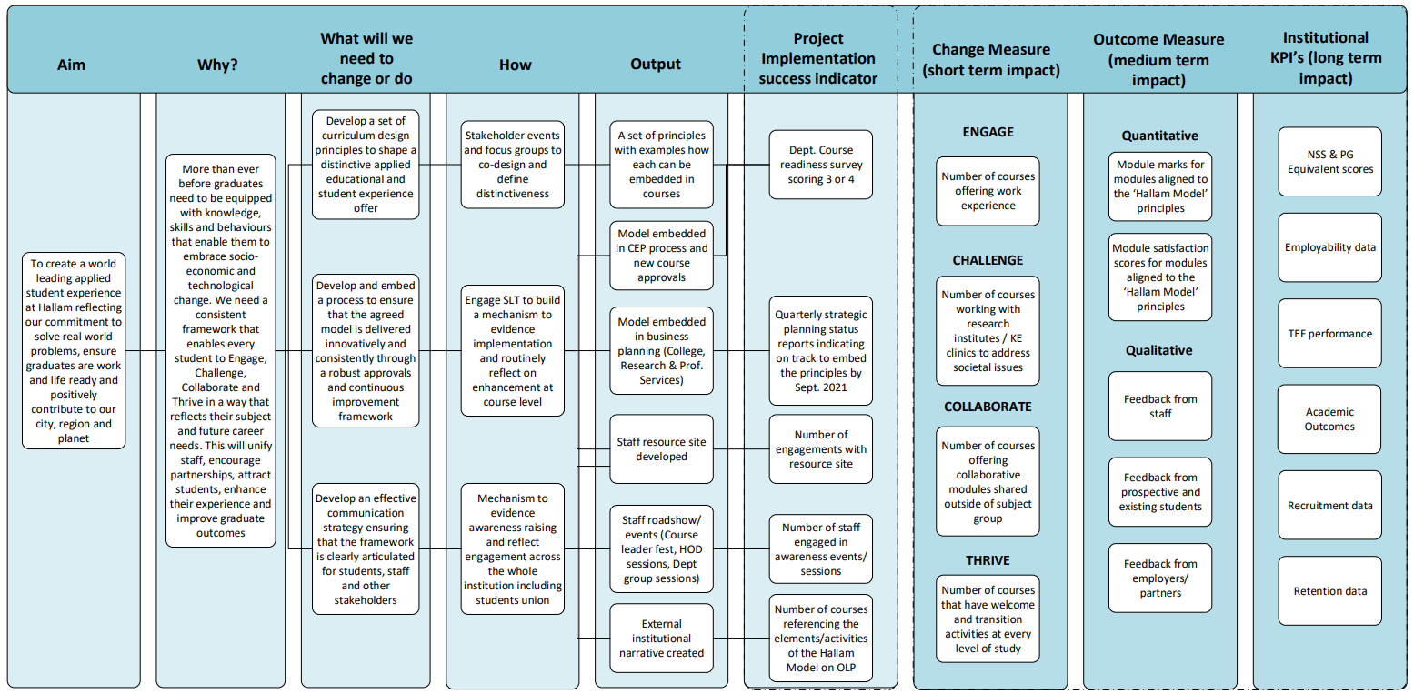
The Hallam Model: Logic Chain

