Slide 1
Maytas Hub – Locate your completed Skill Scan

Slide 2
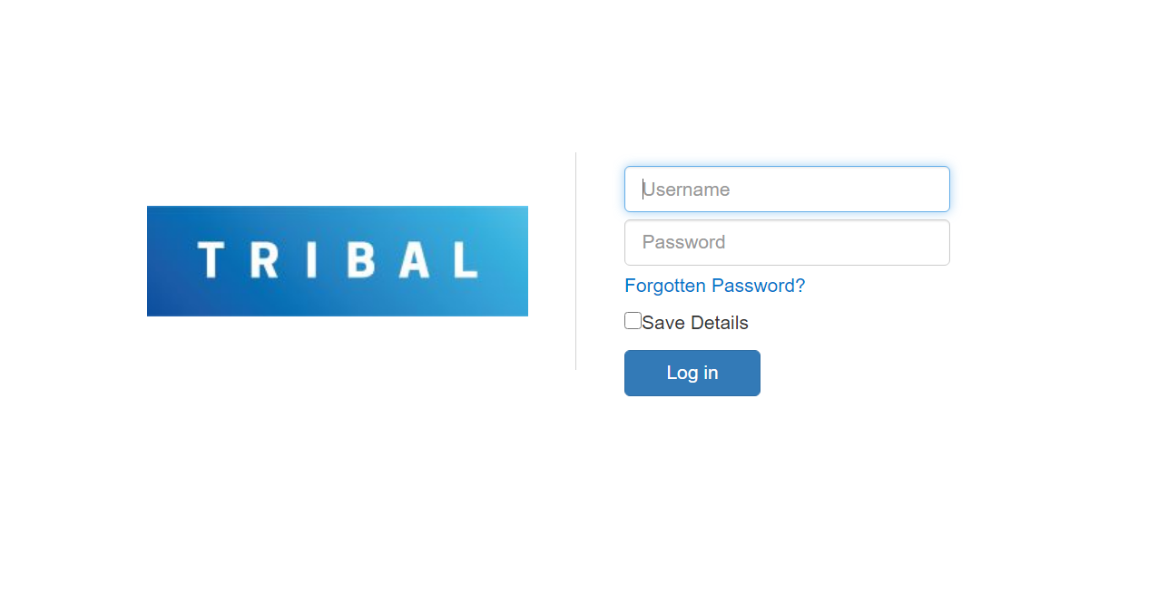
1. Log-on with the same details you used to complete your initial Skill Scan

Slide 3
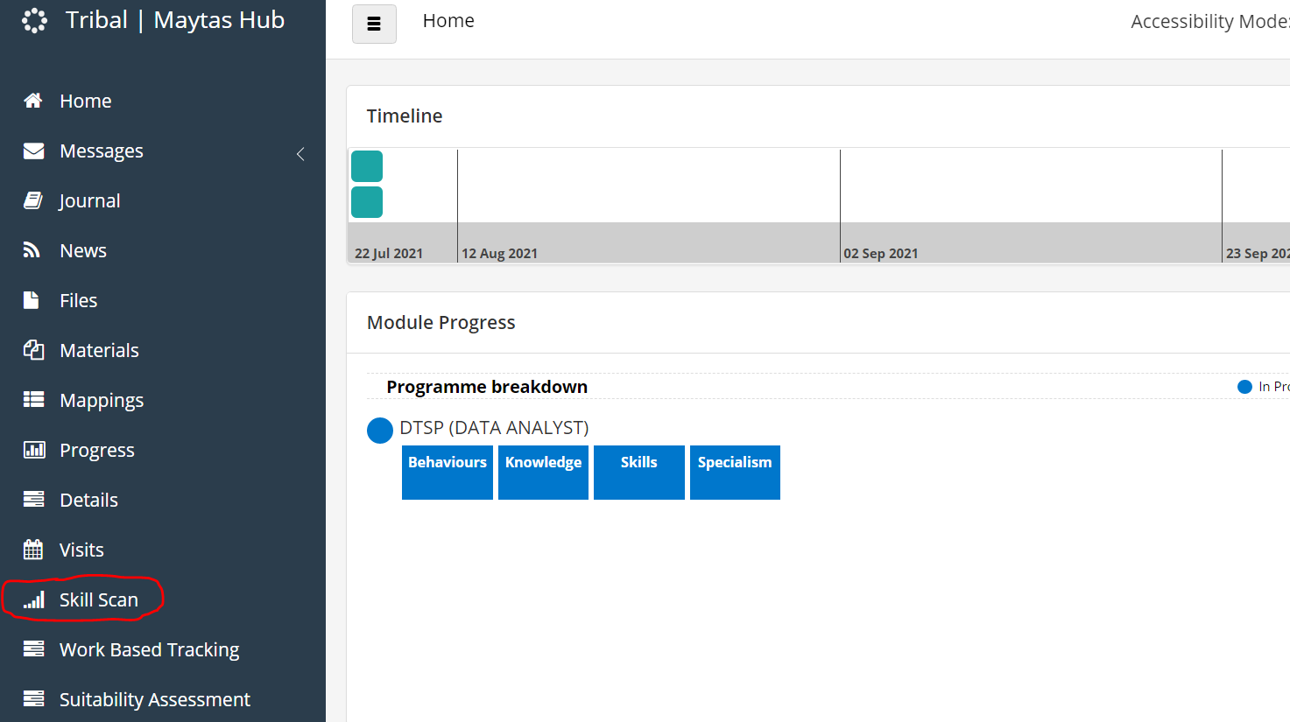
2. Highlighted in Red is the area where you can locate your completed Skill Scan.

